Slide 1

Browsers -Getting started
JS

Slide 3
Installations
Text editor – Sublime / Notepad++ or IDE
GitHub account & GIT
Postman
Node
Browser
Accounts
Heroku
Netlify

Slide 4
Reads
https://stackoverflow.com/questions/1517582/what-is-the-difference-between-statically-typed-and-dynamically-typed-languages
https://stackoverflow.com/questions/17253545/scripting-language-vs-programming-language#:~:text=Scripts%20are%20generally%20written%20to,is%20use%20to%20build%20applications.&text=Some%20programming%20languages%20that%20are,code%2C%20and%20is%20subsequently%20run.

Slide 5
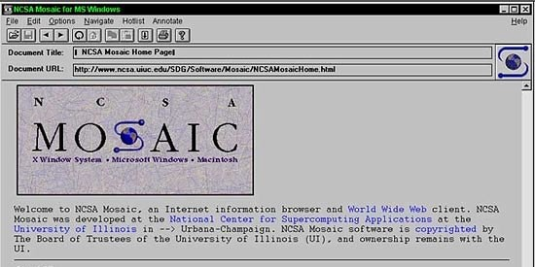
First Web Browser
Andreessen and colleagues leave NCSA to form "Mosaic Communications Corp" (Netscape).

Slide 6
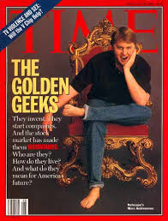
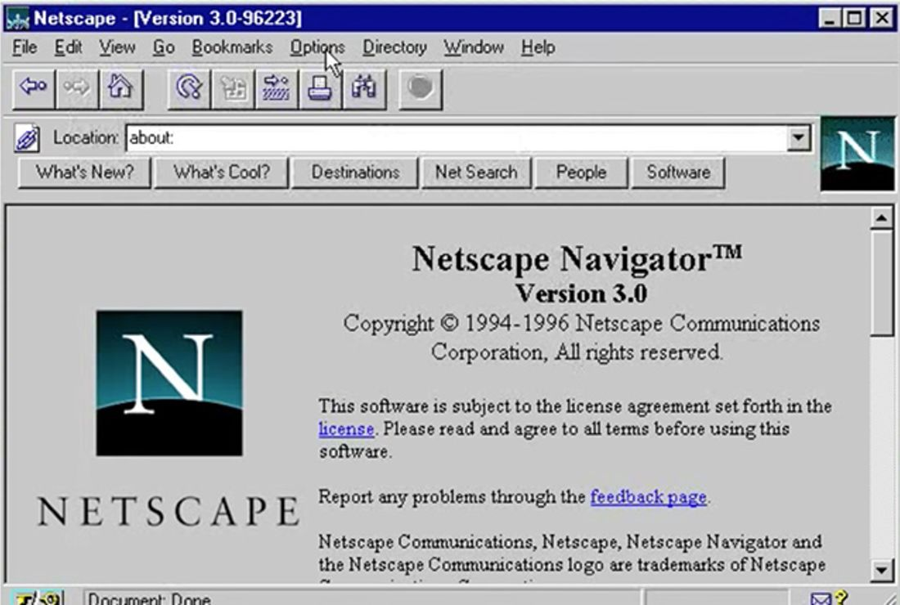
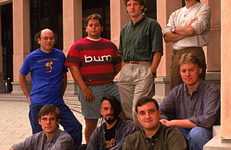
http://www.internethistorypodcast.com/2014/04/on-the-20th-anniversary-an-oral-history-of-netscapes-founding/

Slide 7
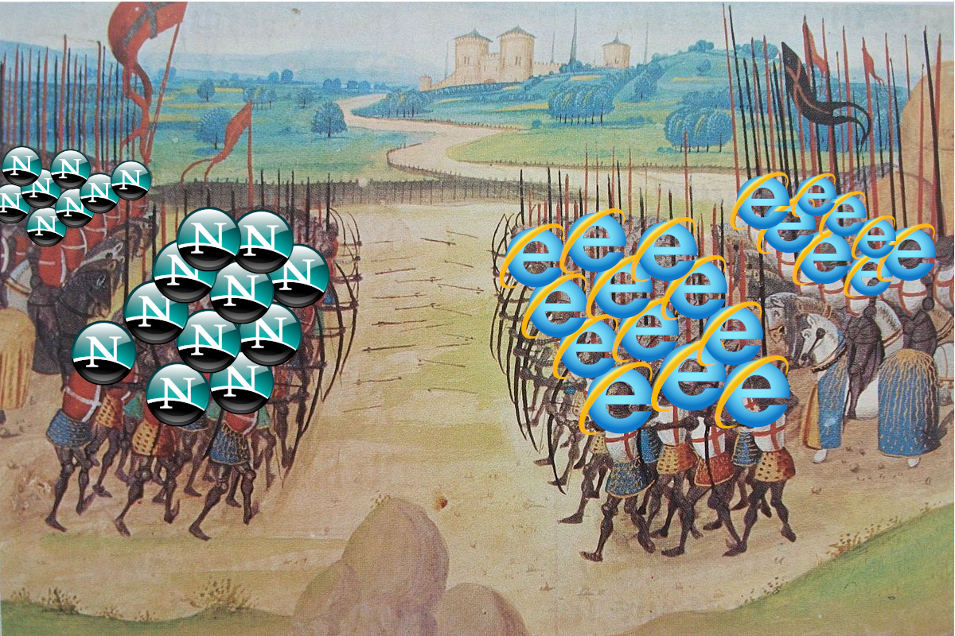
Browser Wars https://www.youtube.com/watch?v=VANORrzKX50
Src: https://medium.com/@traciemasek/a-brief-history-of-the-original-browsers-and-the-first-browser-war-7823fdf756fe

Slide 8
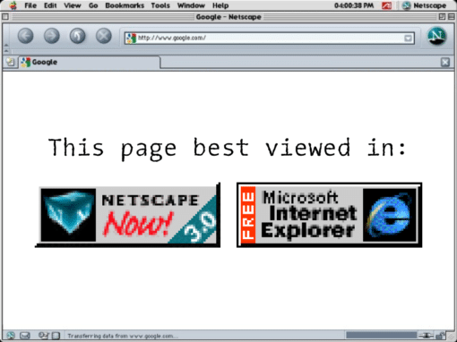

Slide 9
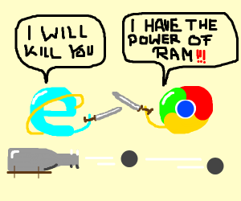
Browser War II

Slide 10
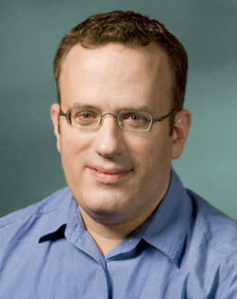
What is JavaScript?
Created by Netscape - 1995
Originally called LiveWire then LiveScript
Developed by Brandon Eich
Named to make use of Java market buzz
IE and Netscape renderings are slightly different
JScript created by Microsoft vs JavaScript
Standardized today as ECMAScript

Slide 11

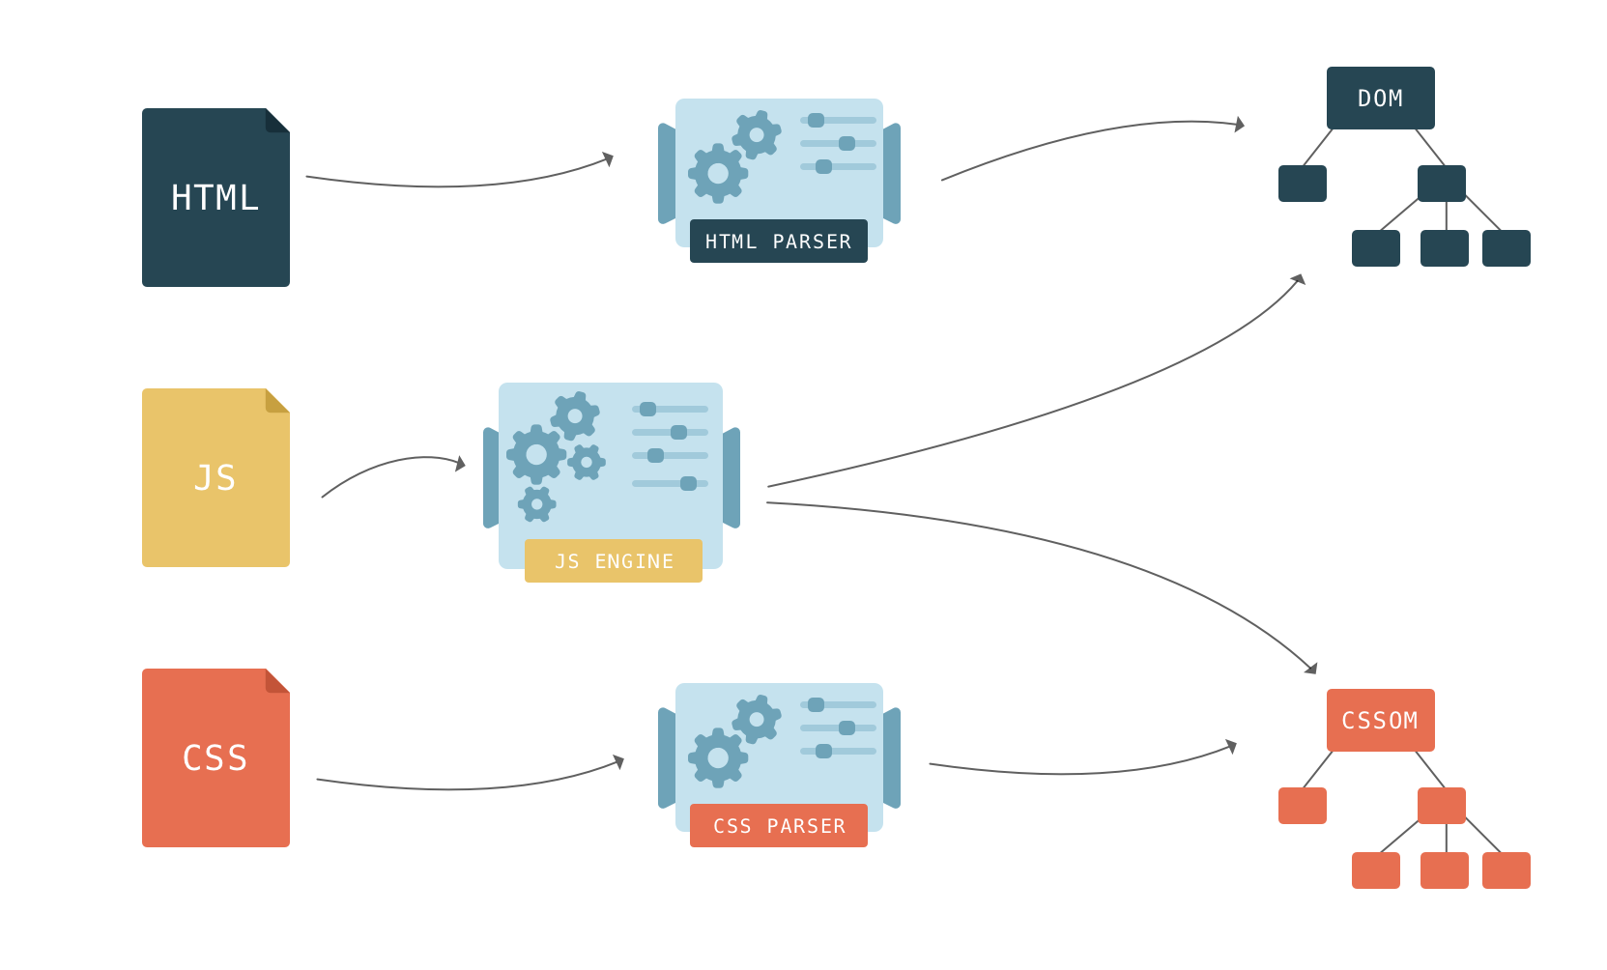

Slide 12
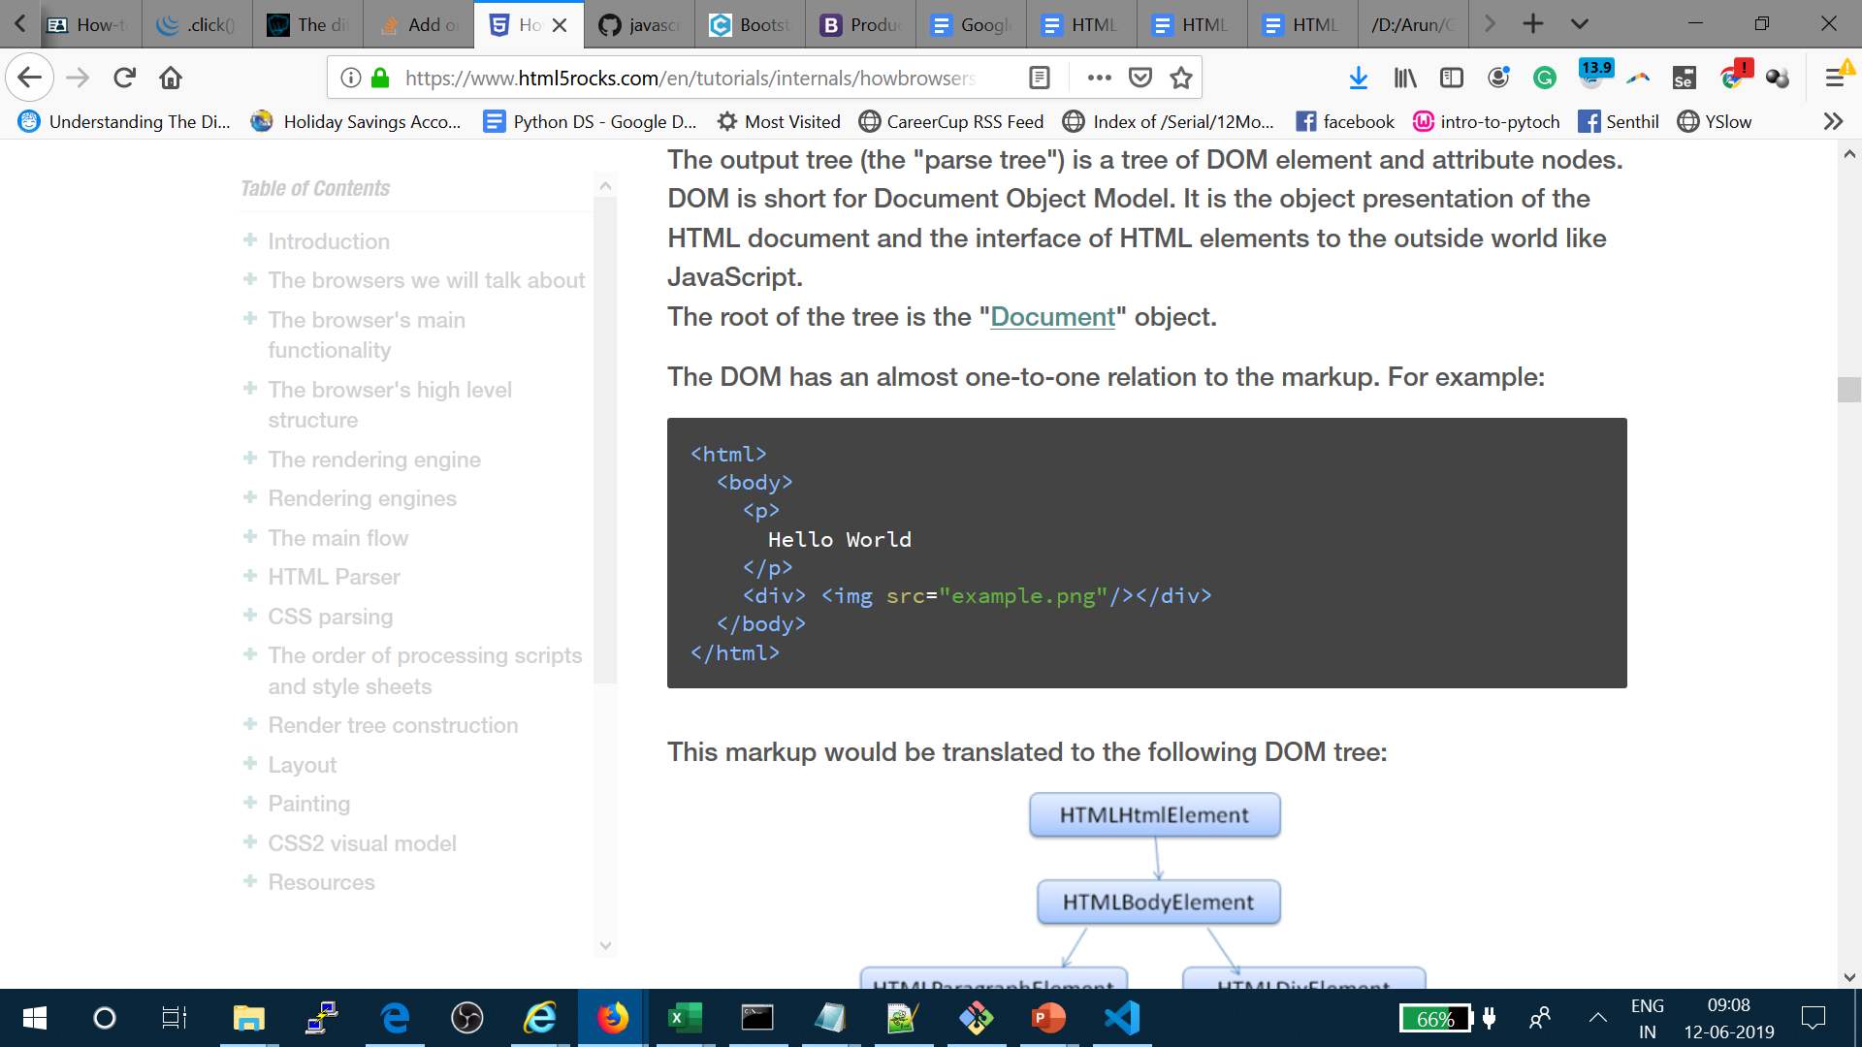
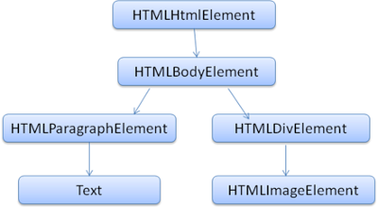
We will only allow at most 20 nested tags

Slide 13
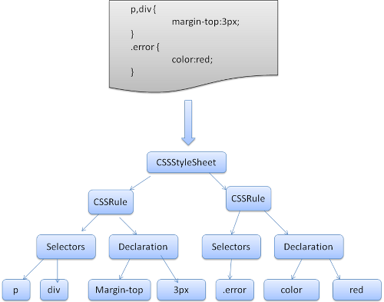

Slide 14

Structure of a Web Browser
User Interface
Browser Engine
Data Storage
Rendering Engine
Networking
JS engine
UI Backend

Slide 15
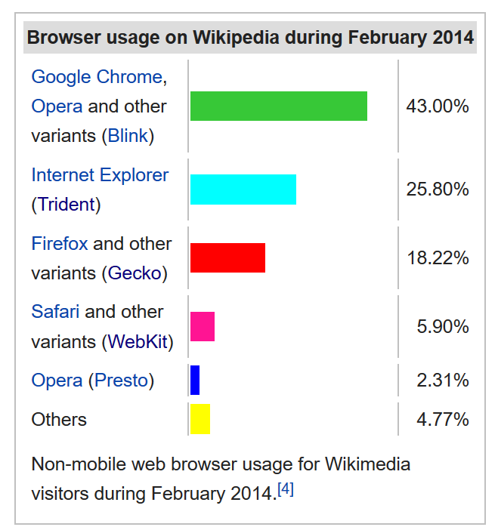
Layout engine or rendering engine

Slide 16
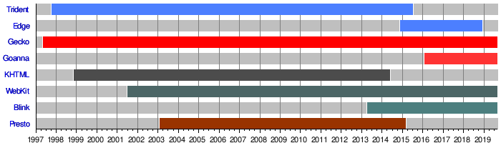
Layout engine or rendering engine

Slide 17



Rendering Engine
JS Engine
Blink
V8
Gecko
SpiderMonkey
Trident – IE
EdgeHTML - Edge
Chakra
Webkit
Nitro

Slide 18
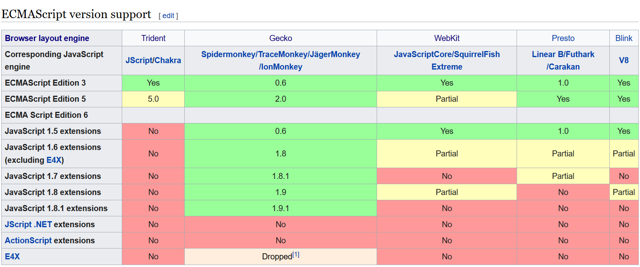
JavaScript engine or ECMAScript engines

Slide 19
Java
Scheme
Self
JavaScript
Programming Paradigms
https://cs.lmu.edu/~ray/notes/paradigms/#:~:text=A%20programming%20paradigm%20is%20a,thing%20(like%20a%20language).

Slide 20
Design of JS - JavaScript
2 simple ideas
Key : Value - Everything
Asynchronous – I wont Block your work

Slide 21
JavaScript - Sandboxed
JavaScript - Stripped
Browser
Nodejs
JavaScript

Slide 22
Operation Sysatn
Operation Sysatn
Operation System
Operation System
Chrome Browser
Chrome Browser
<Script>filename.js</Script>
node filename.js
JavaScript - Sandboxed
JavaScript - Stripped
Chrome Browser
Node.exe
JS engine – V8
JS engine – V8
JavaScript – Run in FE
JavaScript – Run in BE

Slide 23
Google Chrome
Blink
Fork of WebKit
C++
Developed in-house by Google as part of The Chromium Project, a project “to open-source the code for the Google Chrome browser”
https://docs.google.com/document/d/1aitSOucL0VHZa9Z2vbRJSyAIsAz24kX8LFByQ5xQnUg/edit
V8 - Developed in-house by Google as part of The Chromium Project - Used in Node.js!
Mozilla Firefox
Gecko - Developed in-house by Mozilla - Written in Rust!
SpiderMonkey - The first JavaScript engine in history. Developed by Brendan Eich, the creator of JavaScript, while he was at Netscape.

Slide 24
Safari
WebKit - Created by Apple as a fork of the KHTML and KJS engines from Konqueror, a web browser developed by KDE.
Nitro (formerly SquirrelFish)
Edge
EdgeHTML - A fork of Internet Explorer’s Trident that was made not-shitty.
Chakra - Open-sourced as ChakraCore. - In 2016, Microsoft created a PR in the Node.js GitHub repo to use ChakraCore instead of V8. This PR was expanded out into its own project and now lives here as a project of the node organization.

Slide 25
Opera
Blink
- Fork of WebKit. Part of Chrome
V8
If something works on Google Chrome, you can expect it to work on Opera due to the identical rendering engine + JavaScript engine used.
Internet Explorer
Trident
Chakra

Slide 26
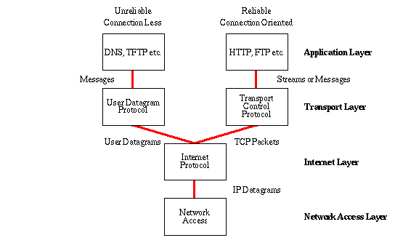
Common Internet protocols
TCP/IP
HTTP / HTTPS
FTP

Slide 28
IP – MAC address – Ports ➔ Discussion
Why IP address when we have MAC address
Why they are called as ports ? Why we need ports?
IMEA – MAC
IP – Mobile Number
Port – USB / C-type

Slide 29
HTTP
Hypertext Transport Protocol
Language of the Web
protocol used for communication between web browsers and web servers
TCP port 80 (443 secure)
RFC 2616 (ver 1.1)

Slide 30
Evolution of HTTP
HTTP/0.9 – The one-line protocol
GET /mypage.html
HTTP/1.0 – Building extensibility
HTTP headers
HTTP/1.1 – The standardized protocol
More than 15 years of extensions
HTTP/2 – A protocol for greater performance
HTTP/3 - HTTP over QUIC
http://www.http2demo.io/

Slide 31
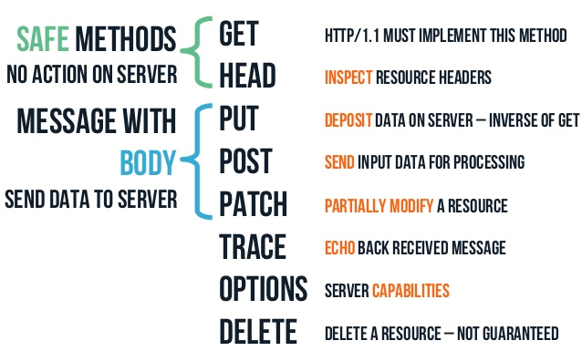
HTTP methods

Slide 32


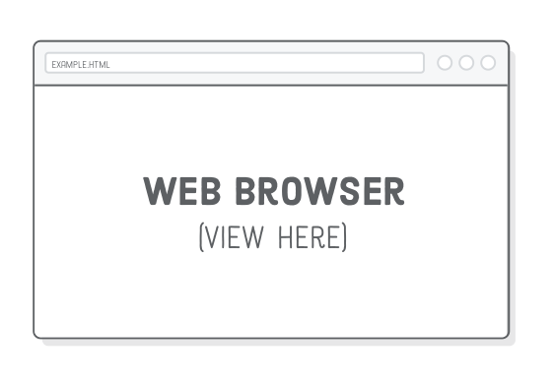


How the Server looks at the URL
Get /index.html
http://234.23.45.6:80/index.html
HTTP request
http://www.guvi.io
HTTP response
(content)
Default browser method is GET

Slide 34
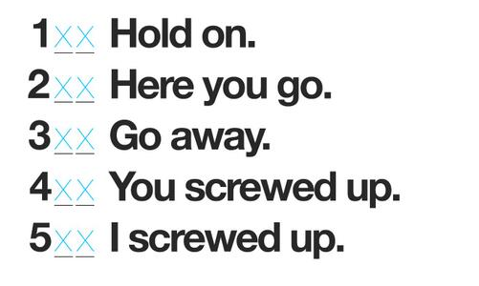
HTTP Return codes

Slide 36
Tasks
Difference between HTTP1.1 vs 2
https://www.youtube.com/watch?v=SmE4OwHztCc
List 5 difference between Browser JS(console) v Nodejs
JSONserver – fake server with POST
https://www.youtube.com/watch?v=-4r0W7TtVTY
Host JSON server in Heroku –
https://github.com/reach2arunprakash/json-server-heroku

Slide 37
Thanks

